Slide 1

ISTA 350
BeautifulSoup, HTML, and JSON
Spring 2020

Slide 2
Previously in ISTA 350 Lab...
Last time
Intro to Web Scraping

Slide 3
Recall...
Assignments 6-8 will involve web scraping
By the end of the 8th assignment, you will have scraped, stored retrieved, parsed, cleaned, and analyzed data from web pages.

Slide 4
BeautifulSoup

Slide 5
BeautifulSoup
BeautifulSoup is a class that is part of Python’s bs4 module and is used to parse HTML.
The BeautifulSoup constructor can take HTML as a bytes object, a string, or a file pointer.

Slide 6
Making BeautifulSoup
>>> import requests, gzip
>>> from bs4 import BeautifulSoup
>>>
>>> url = "https://en.wikipedia.org/wiki/Request%E2%80%93response"
>>> r = requests.get(url)
>>>
>>> #Note: decompression is not always necessary!
>>> info = gzip.decompress(r.content)
>>> soup = BeautifulSoup(info) #BeautifulSoup object
Remember that r.content contains the response content in bytes and the BeautifulSoup constructor can take HTML represented as a bytes object!

Slide 7
Making BeautifulSoup
If you have direct access to the HTML file, you can create a BeautifulSoup object by directly passing the file object as an argument into the BeautifulSoup constructor.
>>> from bs4 import BeautifulSoup
>>>
>>> file_obj = open(“index.html”)
>>> soup = BeautifulSoup(file_obj) # BeautifulSoup object

Slide 8
HTML

Slide 9
HTML Overview
Hypertext Markup Language (HTML) is the language of the front-end of web pages. An HTML file is a plaintext file with the .html file extension.
HTML files contain text surrounded by tags (words enclosed by angle brackets < >).
Tags tell the browser how the web page should be formatted.

Slide 10
HTML Overview
HTML files are made of HTML elements that are nested. Let’s take a look at the HTML for a very simple webpage.
<!DOCTYPE html>
<html>
<head>
<title>Simple Sample</title>
</head>
<body>
<h1>ISTA 350</h1> <!--Heading tag -->
<p>This is a paragraph.</p> <!-- Paragraph tag -->
</body>
</html>

Slide 11
HTML Overview
The text is the content that is in between the start and end tags. We refer to text that is enclosed by start and end tags as an HTML Element.
HTML Element
<tagname> content </tagname>
Start tag Text End Tag

Slide 12
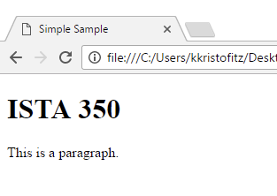
HTML Overview
The previous HTML will produce the following web page:
NOTE: You are only expected to be familiar with HTML, not an expert. If you are comfortable with the concepts in this lab then you know enough to complete the web scraping assignments.

Slide 13
Parsing HTML with BeautifulSoup

Slide 14
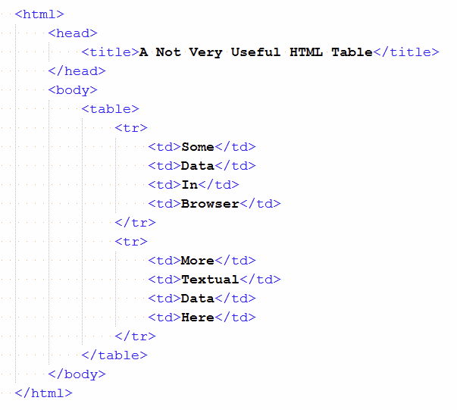
Parsing with BeautifulSoup
Recall the simple HTML table from lecture. The <tr> tag defines a row and the <td> tag defines a standard cell for the table.

Slide 15
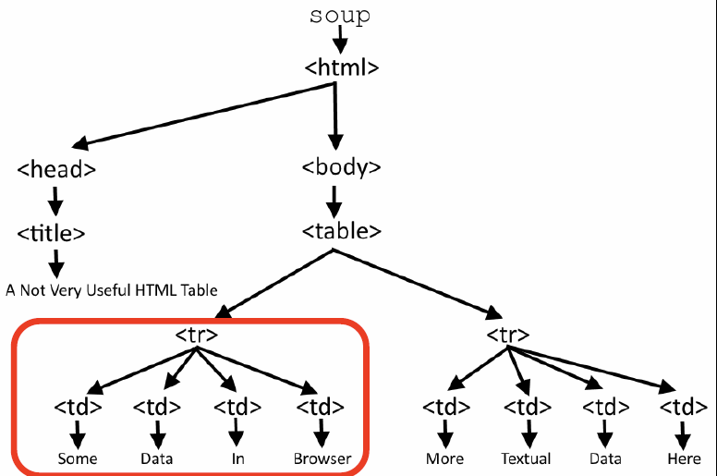
Parsing with BeautifulSoup
BeautifulSoup will interpret the tags as a parse tree and find entire sub trees:

Slide 16

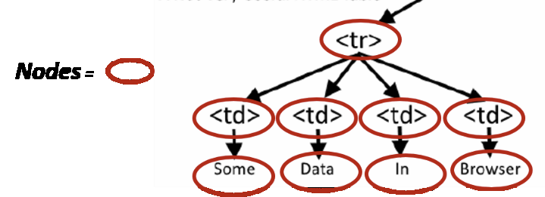
BeautifulSoup Parse Trees
Contain almost every HTML element in the file
The root is the BeautifulSoup object
Every node is an HTML element or string

Slide 17
BeautifulSoup Parse Trees
Elements can be accessed by tag name.
>>> from bs4 import BeautifulSoup
>>>
>>> soup = BeautifulSoup(open(‘index.html’))
>>>
>>> soup.td
<td>Some</td>
Note: you will only get the first element with that tag name.

Slide 18
BeautifulSoup Parse Trees
>>> from bs4 import BeautifulSoup
>>>
>>> soup = BeautifulSoup(open(‘index.html’))
>>>
>>> soup.td
<td>Some</td>
>>> some.td.parent # <tr> is Parent!
<tr>
<td>Some</td>
<td>Data</td>
<td>In</td>
<td>Browser</td>
</tr>
>>> soup.td.text
‘\n Some\n ’
>>> soup.td.next_sibling
‘\n’
You can access the parents, children, and siblings with the attributes .parent, .text, .next_sibling. Many more at:
https://www.crummy.com/software/BeautifulSoup/bs4/doc/

Slide 19
Looping
You will need to know how to iterate through the HTML table tags <tr> and <td>. This can be done by using the find_all() method which will find all the instances of the tag you specify in the HTML.
To get the text that is contained within the <td> elements, you will want to use get_text().

Slide 20
Looping
>>> from bs4 import BeautifulSoup
>>> soup = BeautifulSoup(open(‘index.html’))
>>>
>>> for tr in soup.find_all(‘tr’):
>>> for td in tr.find_all(‘td’):
>>> print(td.get_text())
Some
Data
In
Browser
More
Textual
Data
Here

Slide 21
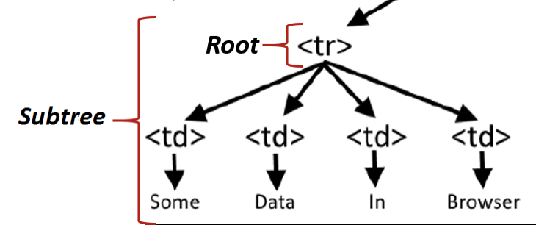
Looping
In the nested for loop:
We first will search the BeautifulSoup object, soup, for all of its <tr> elements.
for tr in soup.find_all(‘tr’)
For each <tr> element that is found
in the parse tree, a subtree exists for
that <tr> element which is the root.

Slide 22
Looping
Then we can search that subtree (rooted at <tr>) for all of the <td> elements:
for td in tr.find_all(‘td’):
Finally, we can extract the text that is contained within each <td> tag.
print(td.get_text())

Slide 23
JSON

Slide 24
JSON
JavaScript Object Notation (JSON) has become the standard format for transmitting data over the web. It is simply a textual format specification for data.
There are two main types of JSON objects:
Object
Array

Slide 25
JSON Objects
Object - an unordered set of name/value pairs
An object begins with { (left brace) and ends with } (right brace). Each name is followed by : (colon) and the name value pairs are separated by a , (comma). What built-in type this remind you of?
{“a”:1, “b”:2, “c”:3}
Array - an ordered collection of values
An array begins with [ (left bracket) and ends with ] (right bracket). Values are separated by , (comma).
[“a”, “b”, “c”]

Slide 26
JSON and Python
In order to create and interpret JSON objects (type str), you will need to use the dumps and loads methods. These methods allow you to translate from JSON to Python objects, and vice versa.
>>> import json
>>>
>>> json_obj = json.dumps({‘a’:1, ‘b’:2, ‘c’:3})
>>> json_obj
‘{‘a’:1, ‘b’:2, ‘c’:3}’ # Note the type! JSON objects are strings
>>> py_obj = json.loads(json_obj)
>>> py_obj
{‘a’:1, ‘b’:2, ‘c’:3} # Note the type! Python object: dict

Slide 27
JSON and Python
The dump and load methods will allow you to write or read Python objects to/from JSON files. You can only have one JSON object per file. You can put more than one Python object into a JSON file simply by wrapping them up in a dictionary.
>>> import json
>>> a_dict = {‘a’:1, ‘b’:2, ‘c’:3}
>>> with open(‘example.json’, ‘w’) as fp: # Writing JSON object to file
>>> json.dump(a_dict, fp)
>>>
>>> with open(‘example.json’) as fp: # Reading JSON object from file
>>> diff_dict = json.load(fp)
>>> diff_dict
{‘a’:1, ‘b’:2, ‘c’:3}

Slide 28
Exercises
Download and complete the functions in lab10.py

